Slide 1
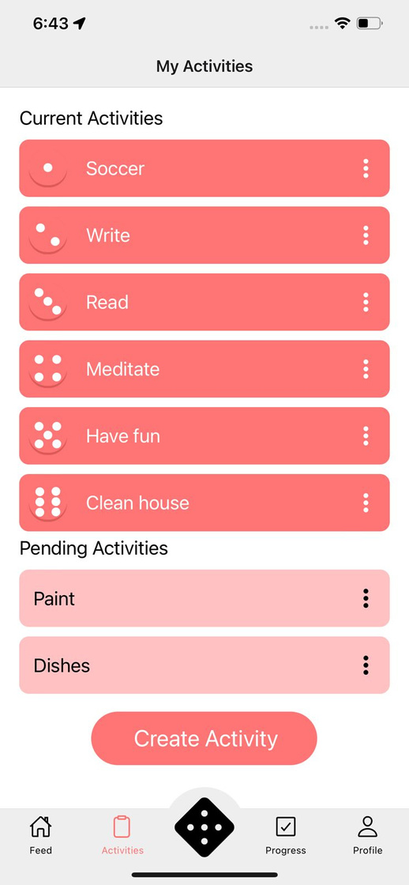
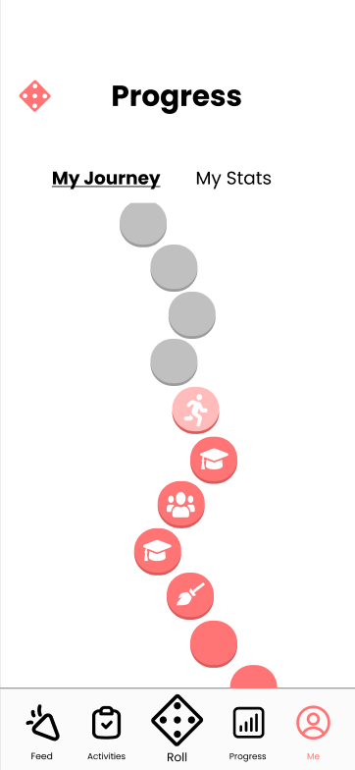
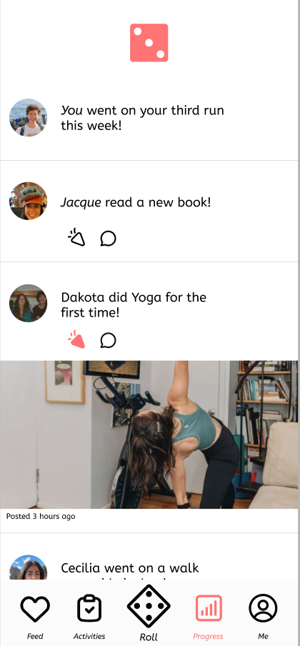
Pedro, Malina, Cecilia, Nazanin
Assignment 8 - Checkpoint
turno
Game your tasks: Make every chore feel like a turn, not a toil.

Slide 2




turno
Assignment 8
team
.
Designer
Developer
Designer
Developer

Slide 3
turno
Assignment 8
problem
there are daily obstacles preventing busy individuals from living an active lifestyle and accomplishing their goals — big or small.
solution
turno allows users to input their activity goals, tasks to accomplish, & habits to build. Users roll the die to determine which of those tasks they should tackle, allowing them to overcome decision paralysis & establish long term habits.

Slide 4

1
Heuristic Evaluation Results
Turno
UI/Product Revisions
2
Agenda
3
Prototype Implementation Status
4
Demo

Slide 5
Heuristic Evaluation Results
Heuristics
High-Level Summary
87 Total Violations
Biggest Problem Categories:
H4: Consistency & Standards: 23 violations
H8: Minimalist Design: 14 violations
H3: User Control: 11 violations
Main issues in UI consistency, group-building features, and activity accountability.
Additional recommended features: vibrations, rewards, and personalized recommendations.
Severity Distribution:
Severity 0: 1
Severity 1: 27
Severity 2: 28
Severity 3: 23
Severity 4: 8

Slide 6
Heuristic Evaluation Results
H1: Visibility of System Status
Severity
3
4
Unsure which page is the home page
The dice number corresponding to the activity is not clear to the user.
H2: Match b/w System & World
Severity
3
4
UI to set a “Recurring activity” is hard to understand.
When does a “week” begin and end?
H3: User Control & Freedom
Severity
3
4
Can’t search from friends when creating a group activity.
Can’t remove someone from group activity.
Users cannot specify the activity they want to create.
Cannot delete activities.

Slide 7
Heuristic Evaluation Results
H4: Consistency and Standards
Severity
3
4
Called “Task” on the dice page but “activity” on all other pages.
H5: Error Prevention
Severity
3
4
Hard to tell if you’re at the top of the feed
No system visibility into required fields for “Add to Dice”.
Users can “complete” a task without having actually done it.
H6: Recognition not Recall
Severity
3
4
The main action of the nav bar (roll) is not emphasized enough.
Cannot differentiate whether an activity is a group activity or an individual one on the “My Activities” page.

Slide 8
Heuristic Evaluation Results
H7: Flexibility & Efficiency of Use
Severity
3
4
It is not clear where to add friends for groups or feed.
H10: Help & Documentation
Severity
3
4
The “complete” button doesn’t look like a slider, but rather a button.
H12: Value Alignment and Inclusion
Severity
3
4
The “congratulations” page is not emphasized enough.
The ability to “Roll Again” is not aligned with the values of the app.
The ability to set recurring activities makes randomization redundant.

Slide 9
1
Heuristic Evaluation Results
UI/Product Revisions
2
3
Prototype Implementation Status
4
Demo

Slide 10

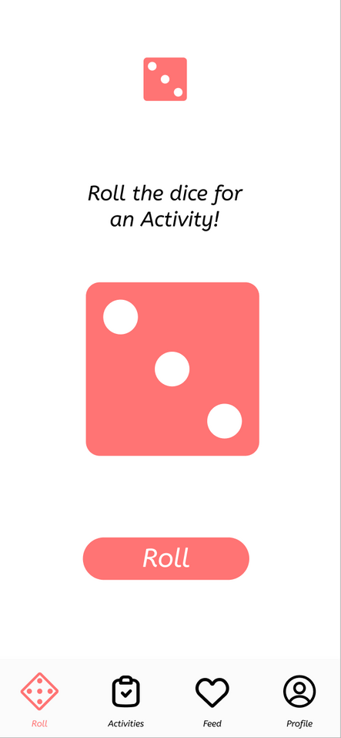
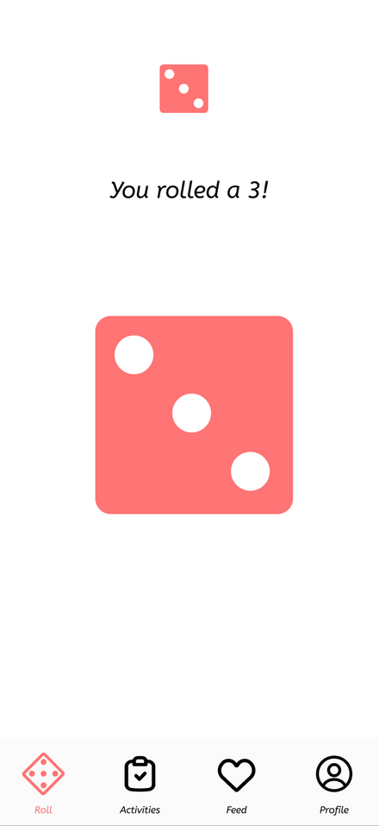
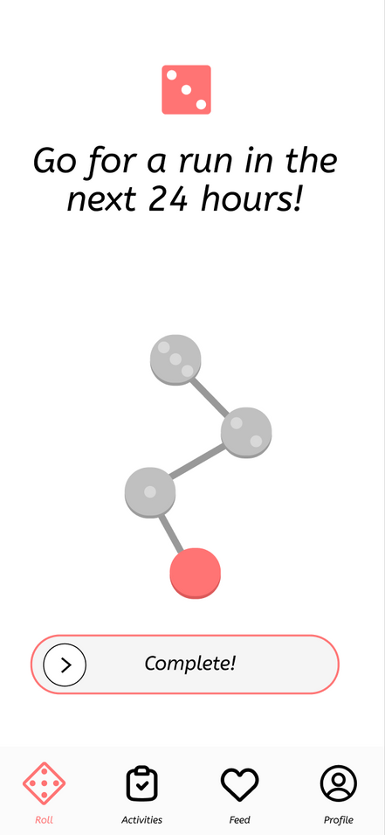
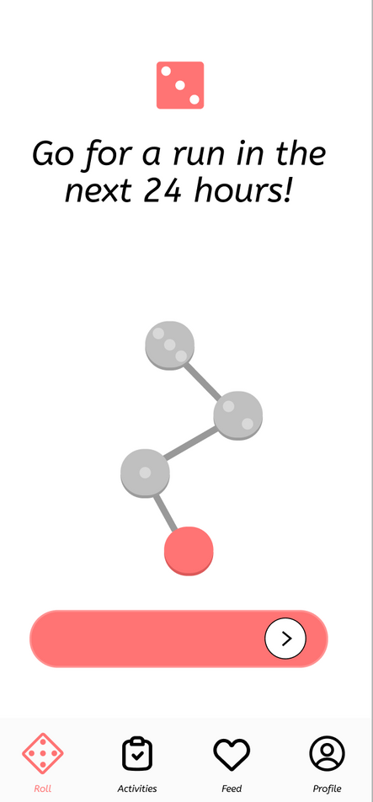
UI/Product Revisions
Before: Complete an Activity

Slide 11
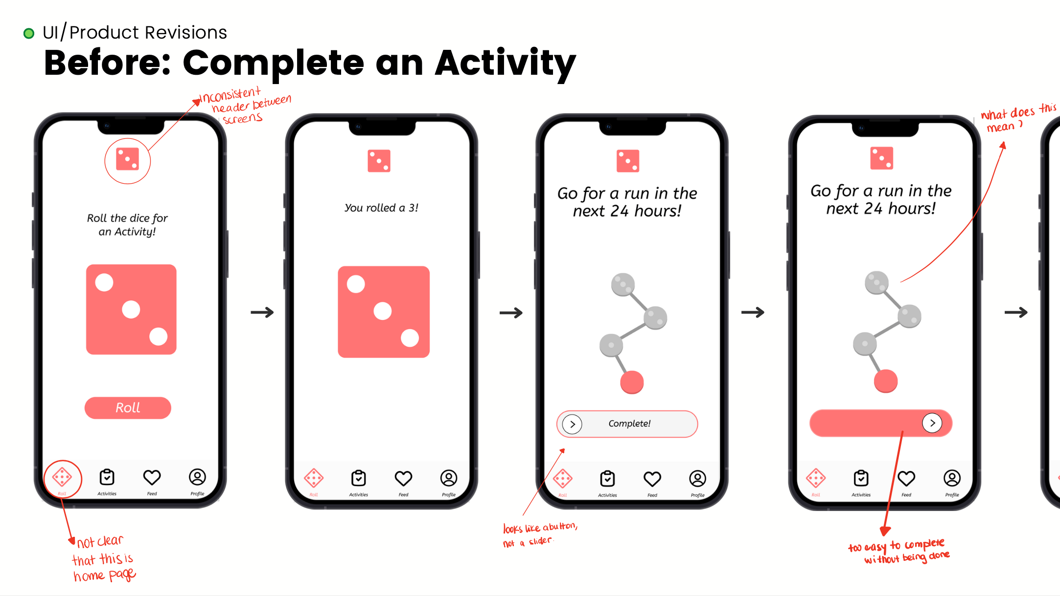

Slide 12
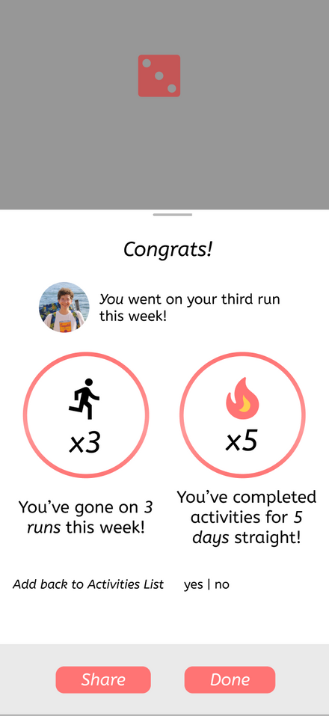
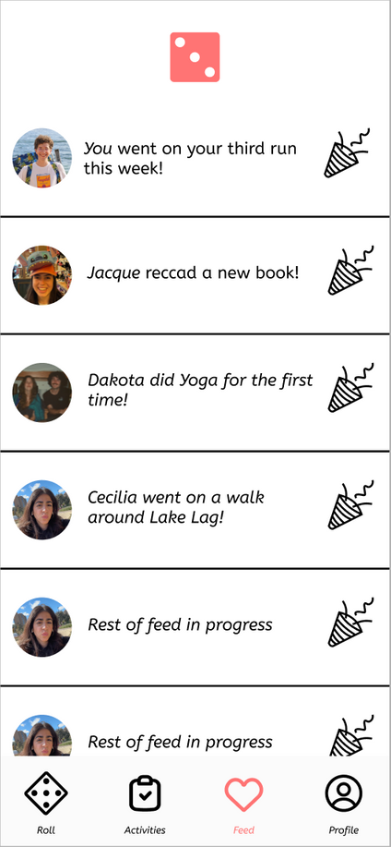
UI/Product Revisions
Before: Complete an Activity
(and share the news with friends!)

Slide 13
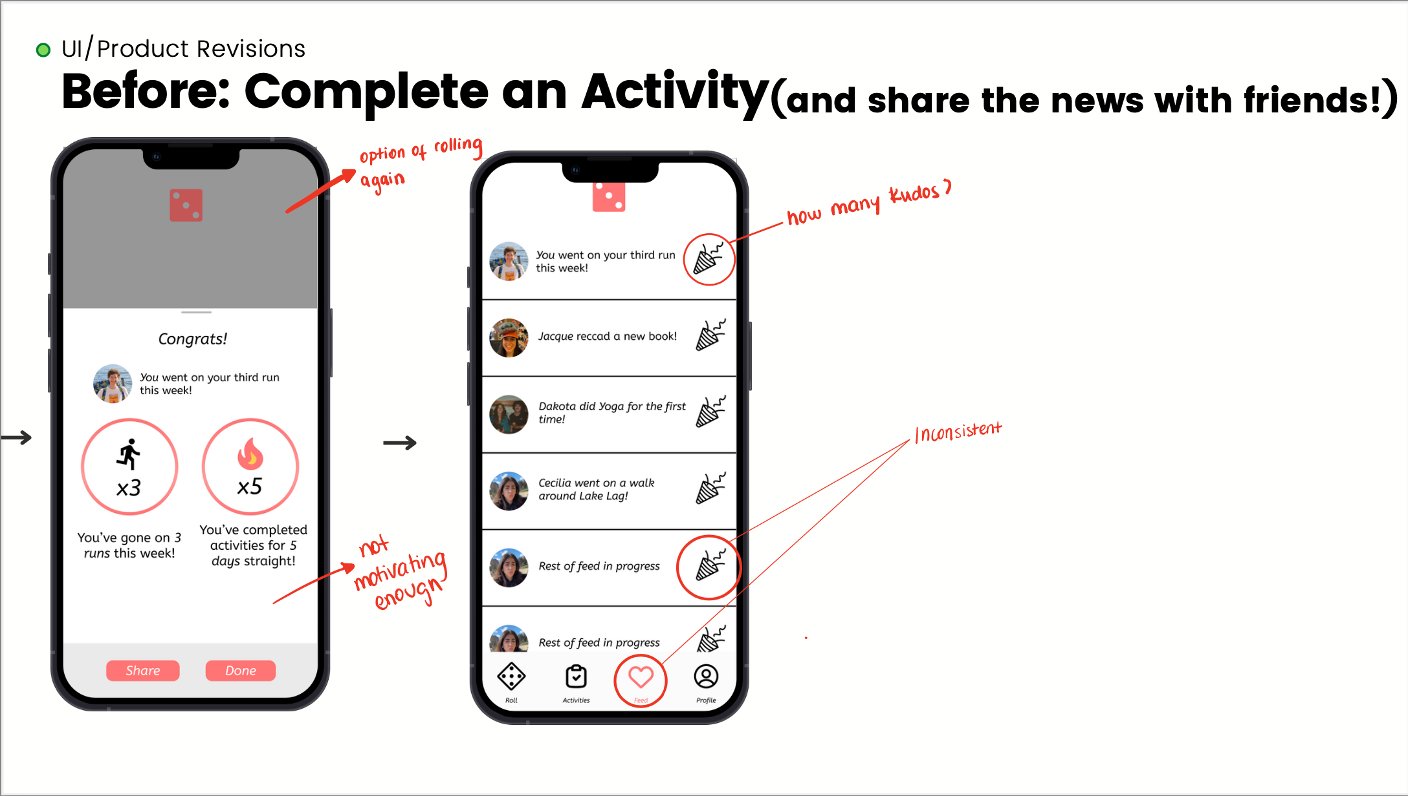

Slide 14
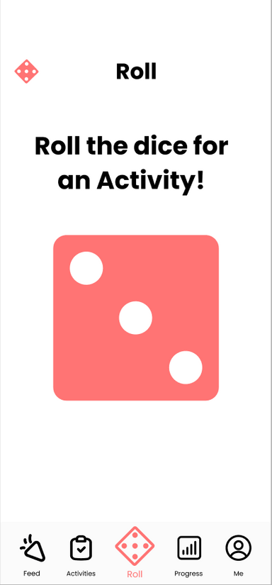
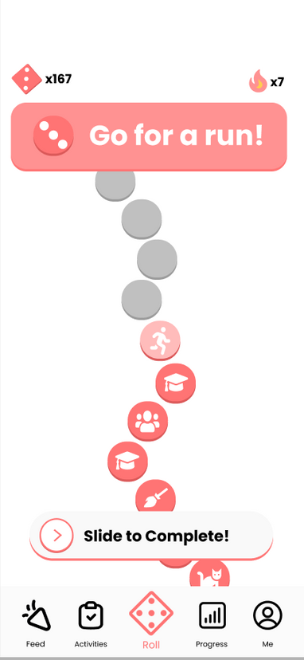
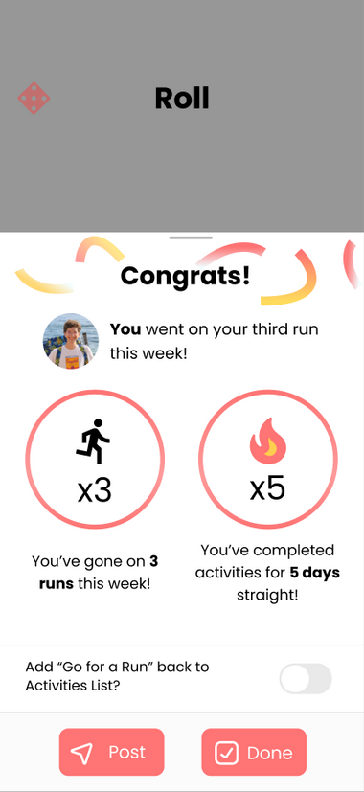
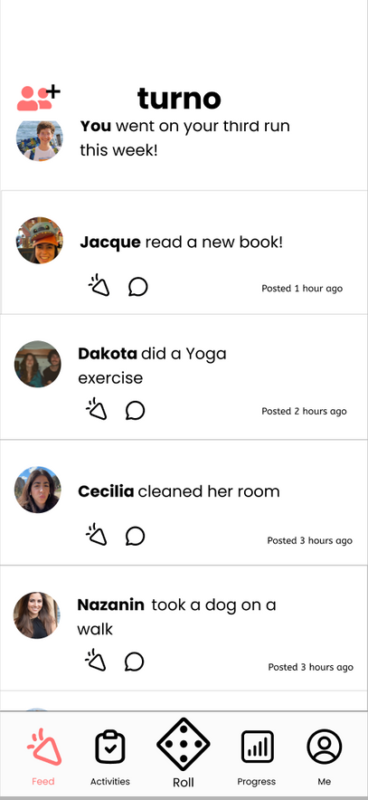
UI/Product Revisions
After: Complete an Activity
(and share the news with friends!)

Slide 15
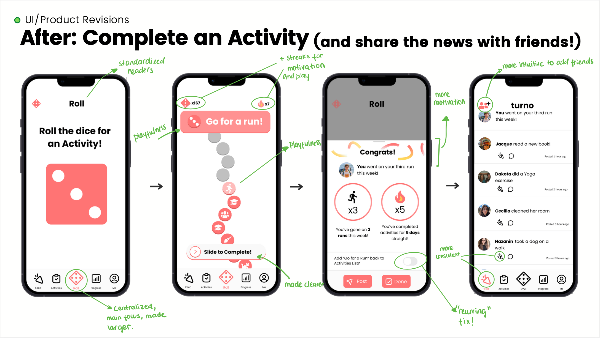

Slide 16
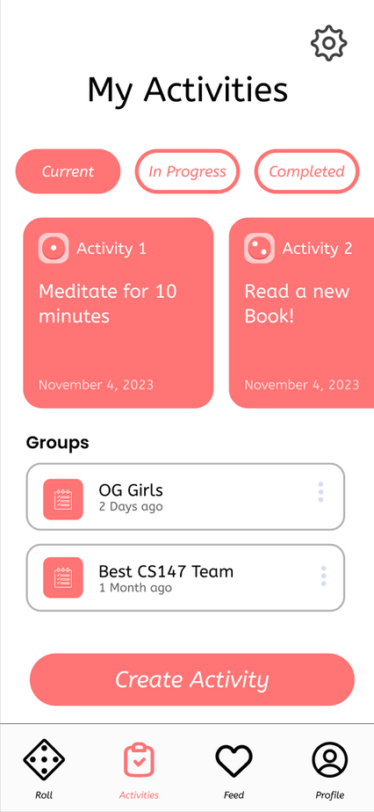
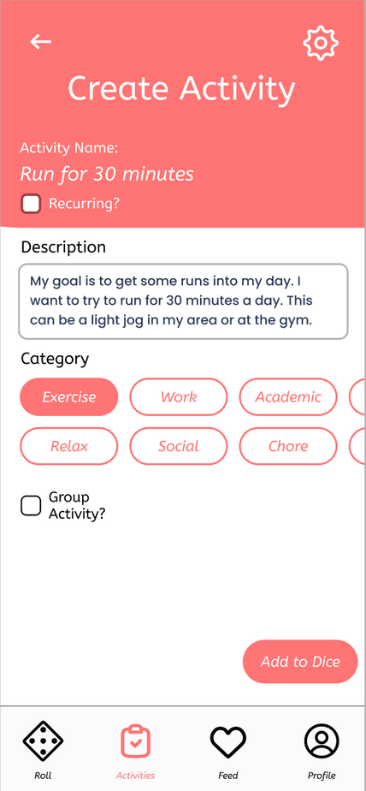

UI/Product Revisions
Before: Create a New Activity

Slide 17
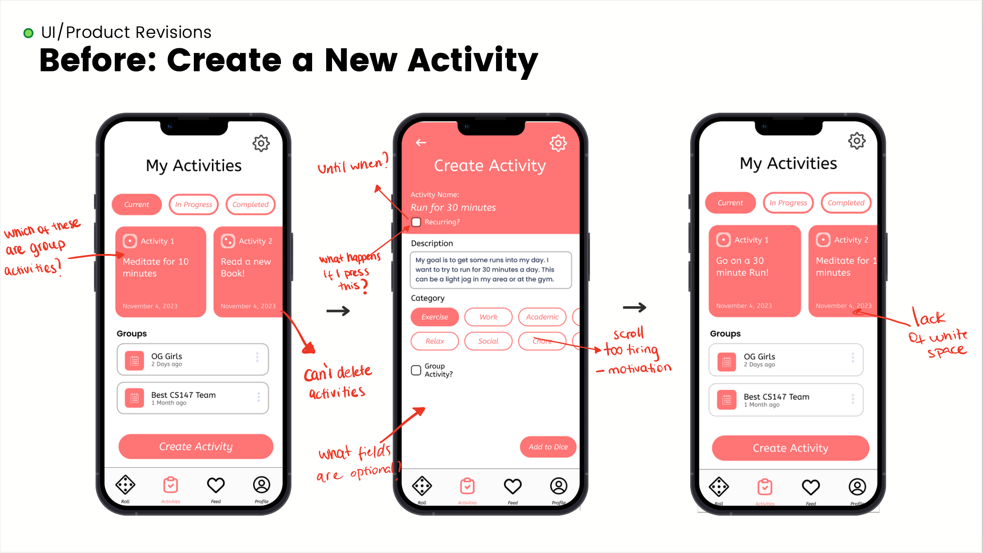

Slide 18
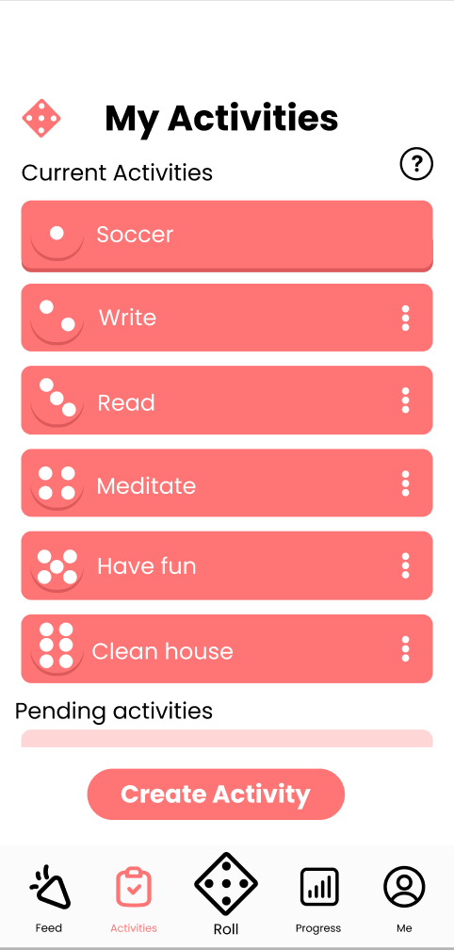
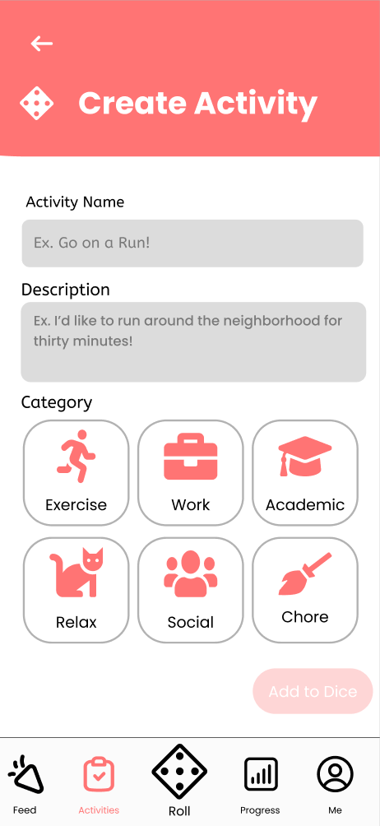
UI/Product Revisions
After: Create a New Activity

Slide 19
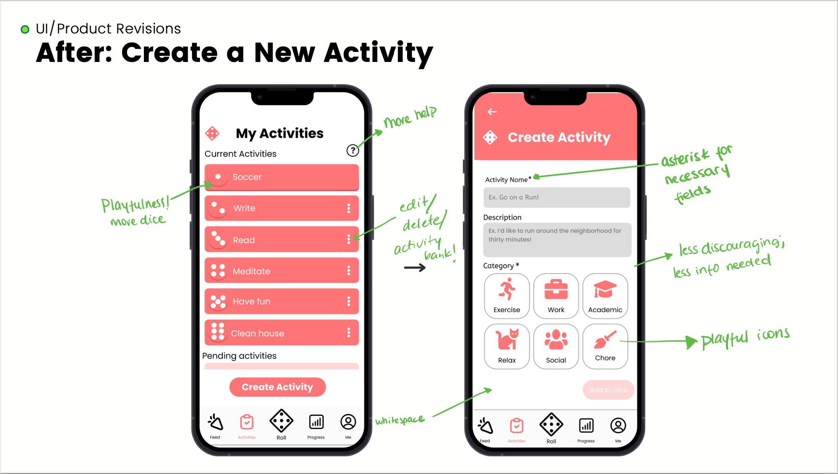

Slide 20
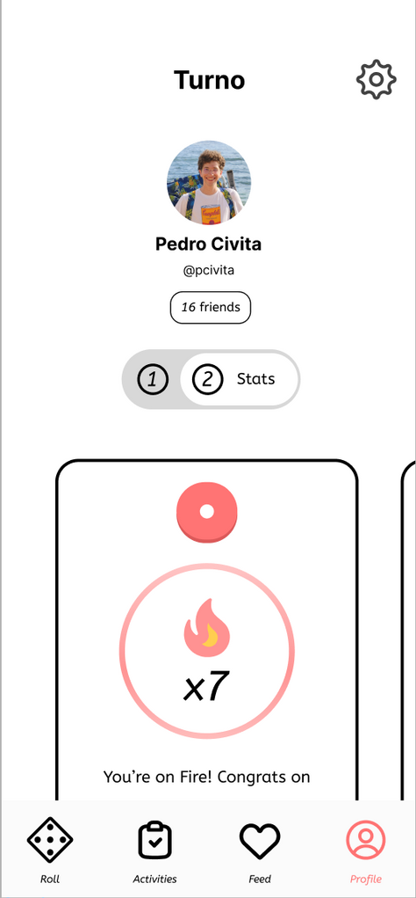
UI/Product Revisions
Before: Check your Activities' Progress and Statistics

Slide 21
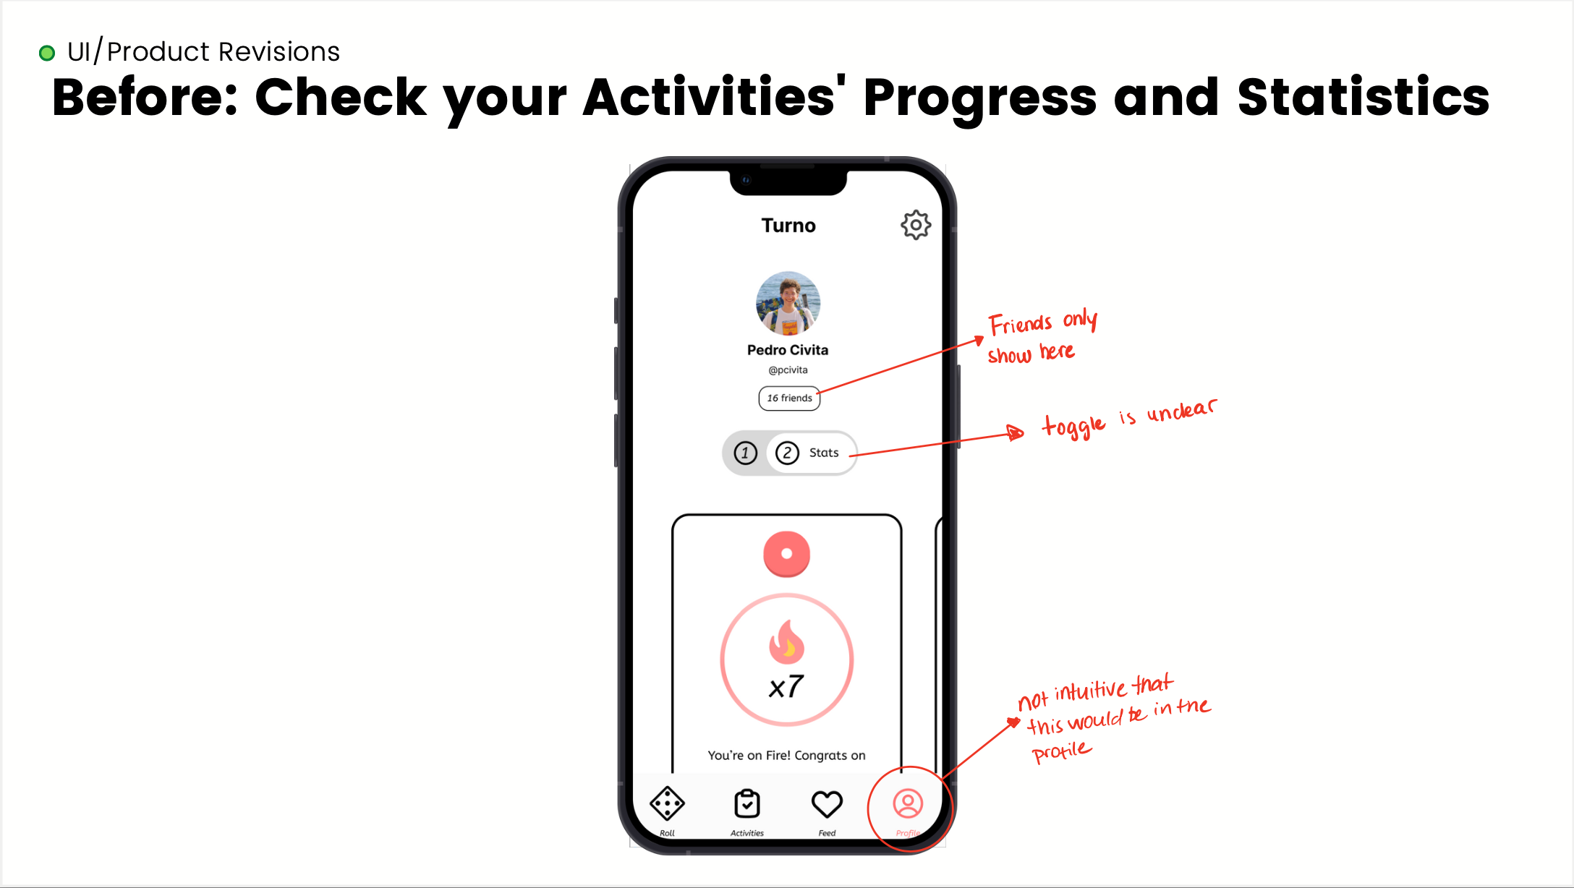

Slide 22
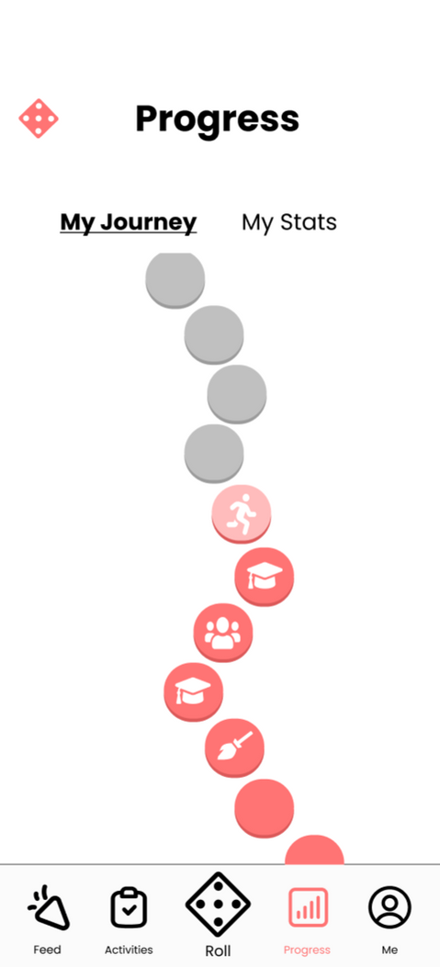
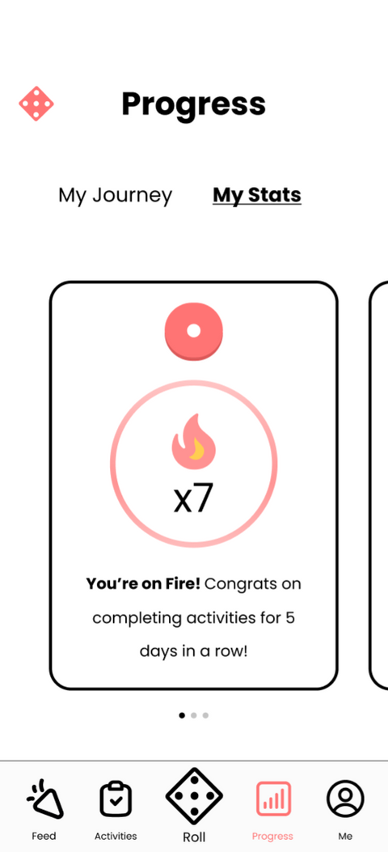
UI/Product Revisions
After: Check your Activities' Progress and Statistics

Slide 23
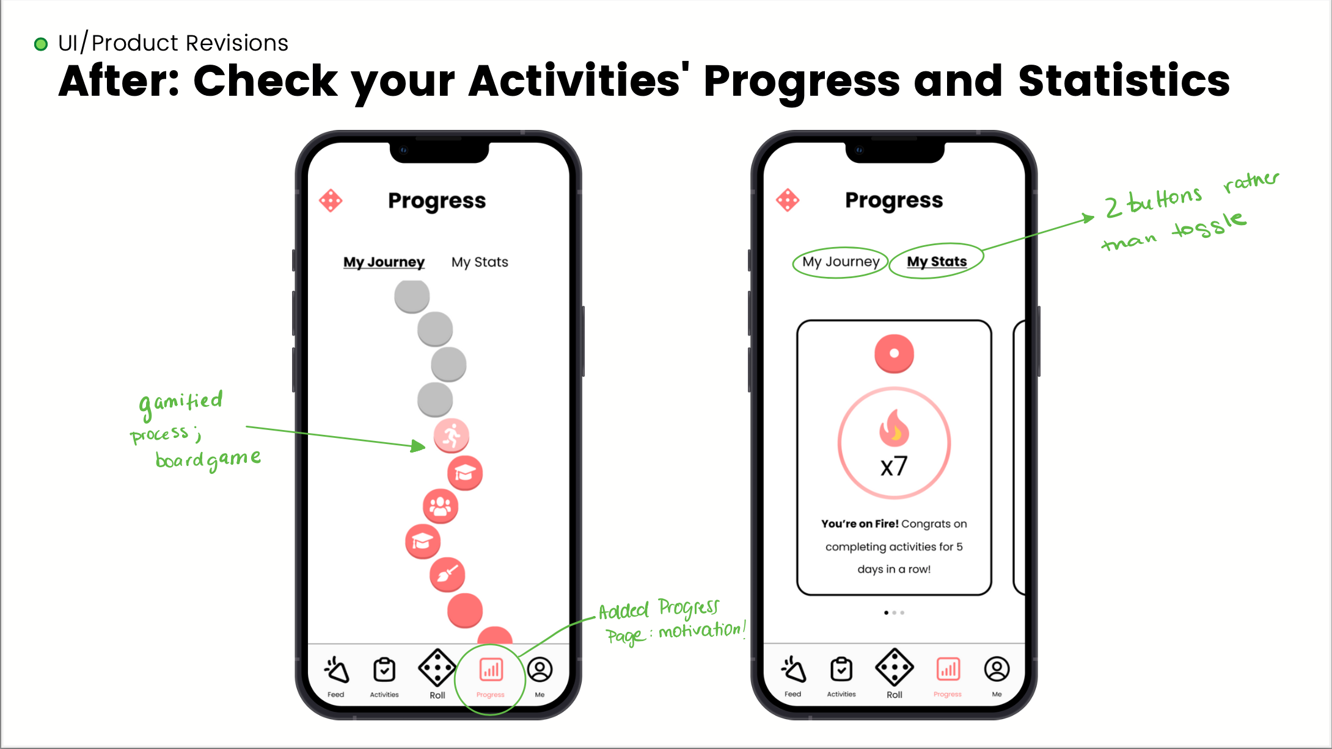

Slide 24
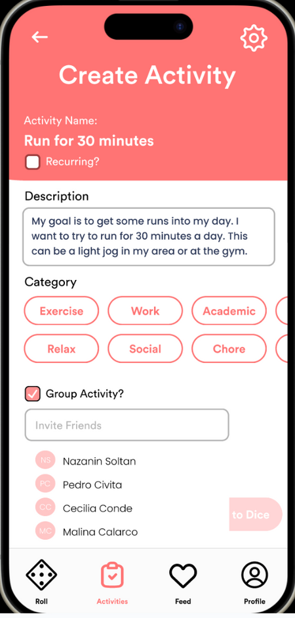
UI/Product Revisions
Before: Create a group activity and invite friends to complete it with you

Slide 25
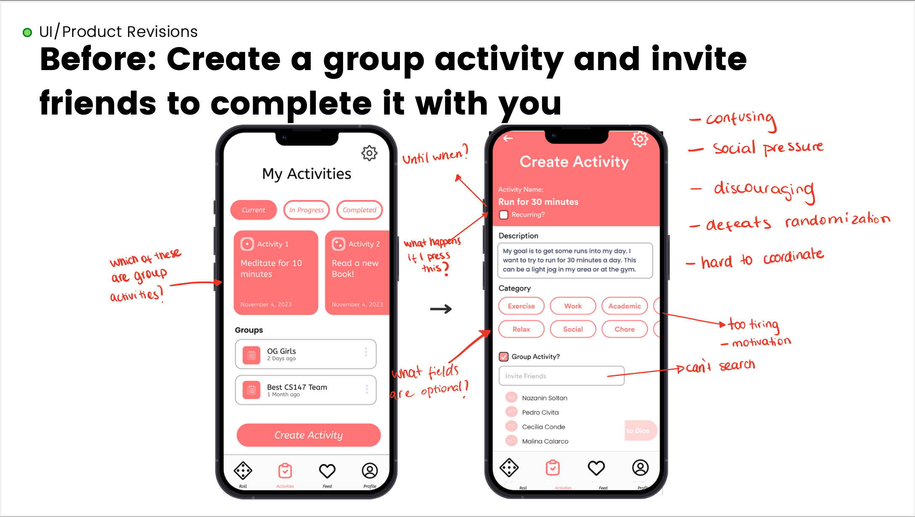

Slide 26
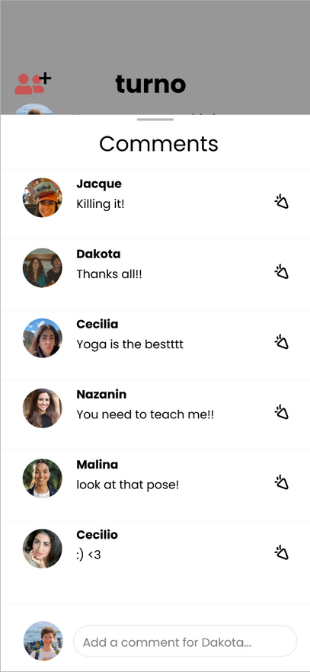
UI/Product Revisions
After: Create a group activity and invite friends to complete it with you
Interact with user posts
Notes:
we thought that going away from the purpose of our app
heuristic evals found it confusing and clashing
goes against integrity because of social/external pressure
difficult to coordinate, discouraging people
distracting from main purpose of our app.
we want any form of social interaction t be encouraging, and not stressful.

Slide 27
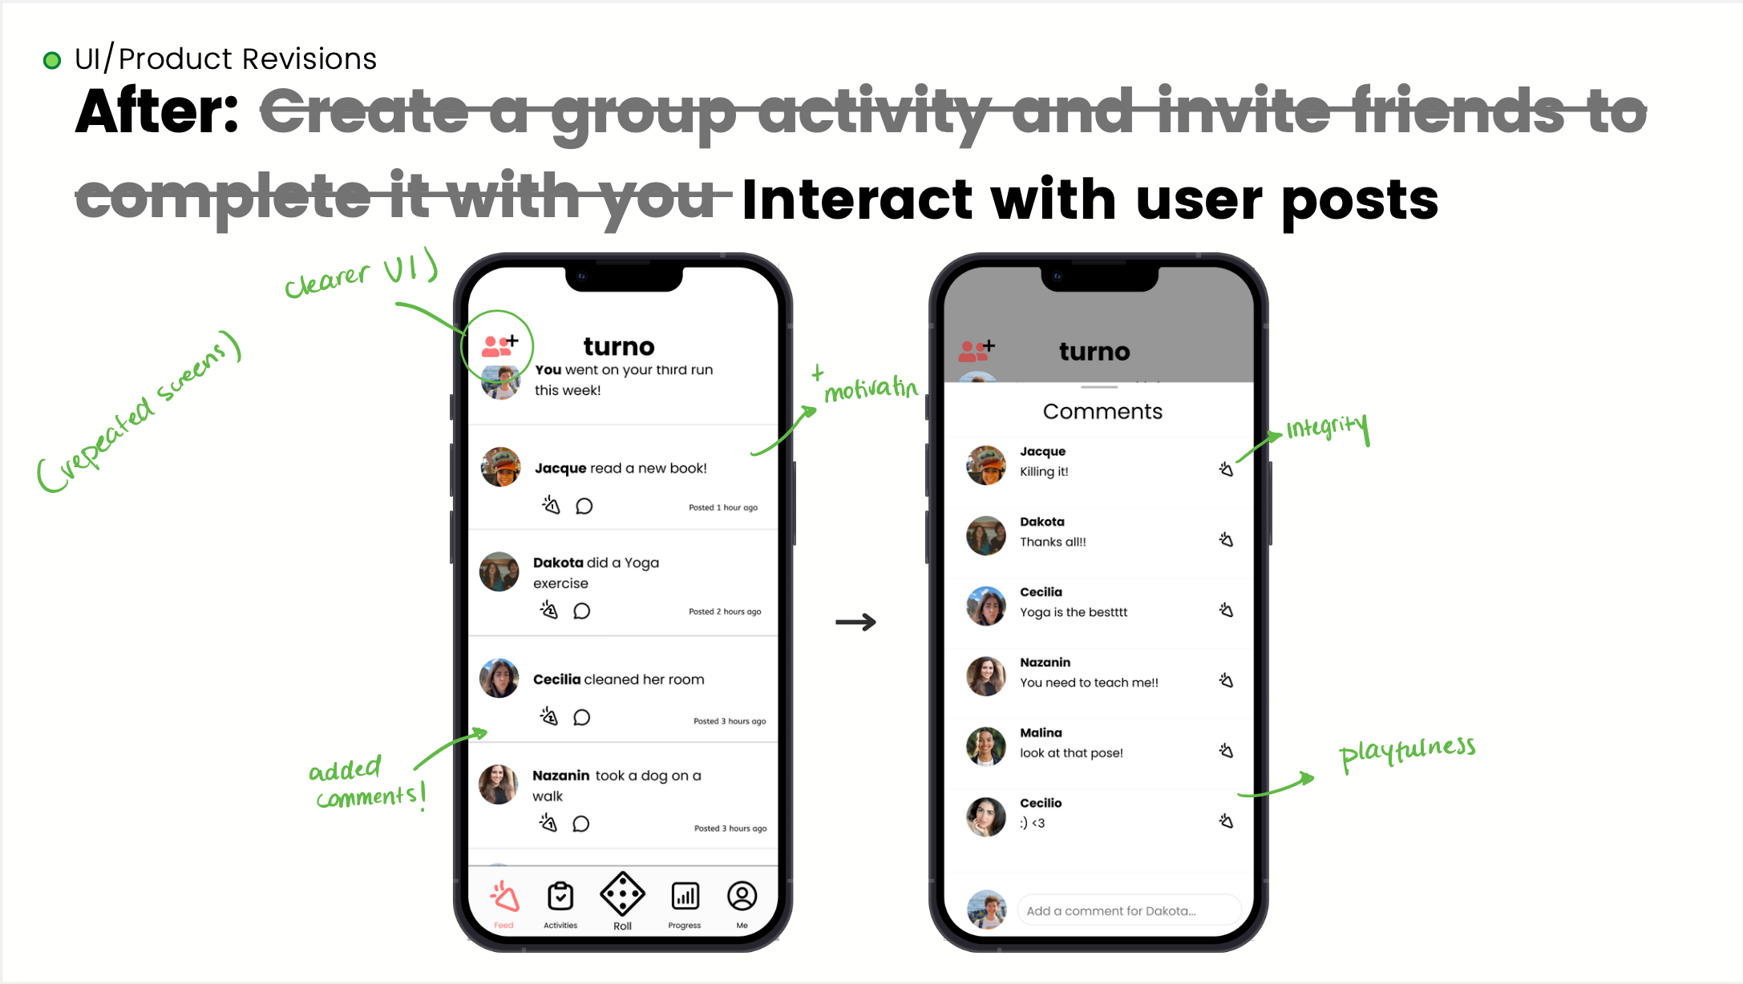

Slide 28
Heuristic Evaluation Results
Changes we didn’t make
H3: There is no way to exit the task page if it is an unwanted activity.
Fix: Add a back button
Our Rationale: A foundational aspect of our App is to let the Dice decide your activity for you. Re-rolling/back buttons would defeat its purpose.
H4: users have to recall their tasks that they rolled rather than seeing it visibly present somewhere
Fix: visually show task in progress app-wide
Our Rationale: While in other parts of the app, having the current task displayed felt intrusive, it is always one click away.
H12: Sharing with friends tool can foster negative competition.
Fix: Remove sharing
Our Rationale: We believe (and tested) that the lighthearted nature of sharing progress can be a great motivator for people wanting to do activities!

Slide 29
1
Heuristic Evaluation Results
UI/Product Revisions
2
3
Prototype Implementation Status
4
Demo

Slide 30
Prototype Implementation Status
Status
Framework & Tools
Front-End: React-Native, Javascript
Other tools: Expo, Figma
Creating an activity and adding it to the die:
Go to Activities page
Click on Create Activity
Fill out Activity name, description, and category, and click "add to dice".
Implemented Features

Slide 31
Prototype Implementation Status
Unimplemented features & plans to finish
Task 1: Complete an activity (Build Dice Page, linked to activities page)
Task 3: Checking your stats (build Progress page)
Task 4: Interacting with user posts (Wizard of Oz - well in progress with this!)
unsure how to do: animation, sound effect
Hard-Coded & Wizard of Oz
Activities list pre-loaded with activities
user automatically assigned a pre-built set of activities

Slide 32
1
Heuristic Evaluation Results
UI/Product Revisions
2
3
Prototype Implementation Status
4
Demo (here)

Slide 33
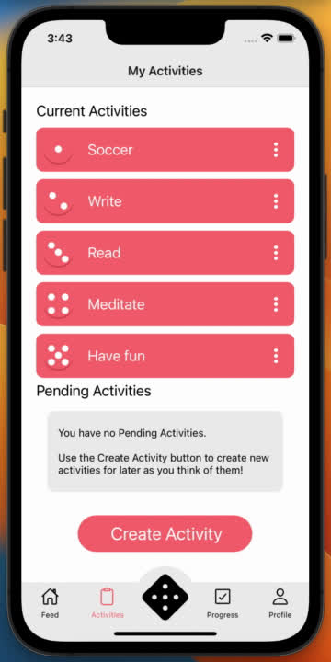

Slide 34

Thank You!
turno

